Slide 1
Optimizing Your Agency's Business Processes through Analytics
Chris Paladino chris.d.paladino@accenture.com
January 30, 2008

Slide 2
Topics
Public Service Value
Analytics in the Public Sector
Public Service Examples
Road Map
Benefits Summary

Slide 3
Public Service Challenges –
Drivers for Analytics
Proliferation
Disorganization
Isolation
Contamination
Regulation
Frustration

Slide 4
Public Service Value
Corporations measure their success through shareholder value. Accenture believes the success of governments can be measured in Public Service Value.
Public Service Value
measures the social outcome value created for citizens
Shareholder Value
measures the economic value created for investors
High Performance
Public Services
High Performance
Companies
Outcomes
Growth
Low Performance
Public Services
Low Performance
Companies
Financial Returns
Cost Effectiveness

Slide 5
Public Service Value Building Blocks
1.
Mission
2.
Core
Functions &
Capabilities
3.
Stakeholders/
Customers
4.
Stakeholders’/
Customers’
Expectations
Building Blocks
Develop Outcomes
Outcomes
What are the end results we aim to deliver
to key internal and external stakeholders?
Developing
Outcomes
Identify Metrics
Raw Metrics
How will we know that we have been successful
In achieving our outcomes?
Developing
Metrics
Filter Metrics
Filtered Metrics
Which metrics can be used to drive the results
we want and will be practical to measure?

Slide 6

Analytics Move to Center Stage
Analytics: The extensive use of data, statistical and quantitative analysis, explanatory and predictive models and fact-based management to drive decisions & actions.
Analytics, statistics, and fact-based decisions are not new to businesses
DSS, ESS, BI, etc were important and provided value, but were often marginal to the mainstream of the business
With Public Service organizations driving value from analytics, the capability moves to center stage.

Slide 7
Forces Driving Trend for Analytics
Demand
  New generation of analytical leaders.
  Growing financial oversight requirements.
  Increasing importance of citizen-centric strategies.
Data
  Maturing enterprise systems.
  Growing standardized external information.
  More data about the physical world.
Technology
  Maturing IT infrastructure and analytical architecture.
  Sophisticated analytical techniques.
  Massive processing power.
  Automated applications with embedded rules and models.

Slide 8
Link from Analytics to Performance
High performance is associated with more extensive and sophisticated use of analytical capabilities.
High performers have a greater analytical orientation than low performers.
Low Performers
High Performers
Have significant decision-support/analytical capabilities
23%
65%
8%
Value analytical insights to a very large extent
36%
33%
Have above average analytical capability within industry
77%
23%
Use analytics across their entire organization
40%

Slide 9
Integrating Analytics into Processes
Financial
  External Reporting (Compliance, Audits, etc.)
  Management Reporting/Scorecards
  Investment Decisions
  Cost Management
Enterprise Performance Management
Human Resources
Research and Development
OCIO/IT

Slide 10
Key Elements
Capabilities
Key Elements
Organization
Insight into performance drivers
Choosing a distinctive capability
Performance management and strategy execution
Process redesign and integration
Human
Leadership and senior-executive commitment
Establishing a fact-based culture
Securing and building skills
Managing analytical people
Technology
Quality data
Analytic technologies

Slide 11
Enterprise Analytical Architecture
Data Management
Repositories
Analytical Tools
and Application
Transformation Tools
and Processes
Presentation Tools
and Applications
Metadata
Operational Processes

Slide 12
Examples of Analytics in Public Service
New York City 3-1-1 (detailed Case Study)
Taxpayer Compliance
  Indiana Department of Revenue
  Shenzhen Tax for Joerg
Fraud Detection
  US Department of Revenue (IRS)
  Australian Tax Office (ATO)
Criminal justice
  Deploying police more efficiently, analyzing traffic violations, predictive modeling to catch criminals, social network analysis to identify potential terrorists)
USPS
  Designing delivery routes, truck yield optimization, customer insight
United States Mint

Slide 13

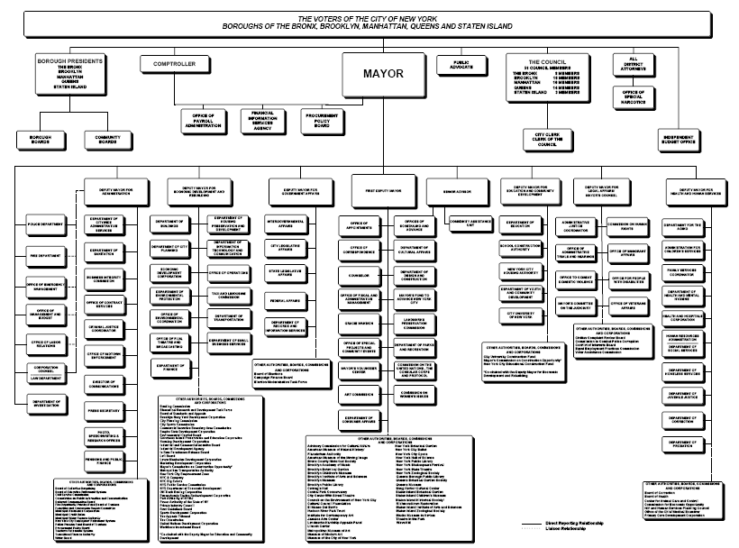

New York City: Large, Complex Organization
Large Number of Agencies and Offices
8.2 million residents
>20 million metro population
>350,000 employees
$60 Billion Expense Budget

Slide 14
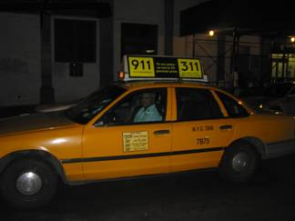
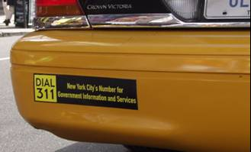
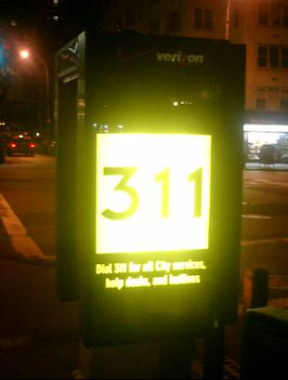
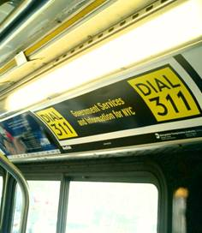

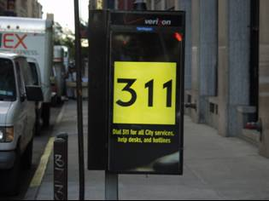
NYC 3-1-1: Customer Service “Nerve Center”
24 hours x 365 days a year
Over 3,000 services
Launched in March 2003
Over 55 Million calls to date (appx. 45,000 a day)
14.4
13.5
10.7
5

Slide 15

Mayor Michael R. Bloomberg
A “Business” approach to government
Outcome oriented; believes in technology
Not afraid to tackle the difficult issues
Wants a legacy that cannot be reversed
NYC IT VISION
NYC transforms the way we interact with residents, businesses, visitors, and employees by leveraging technology to improve services and increase transparency, accountability, and accessibility across all City agencies.

Slide 16
NYC’s Business Intelligence Vision
Management
Information
Enterprise
BI Capabilities
Audiences
Large number of agencies with a VAST amount of management information
Common technologies and BI capabilities
Several audiences with varied BI needs

Slide 17





























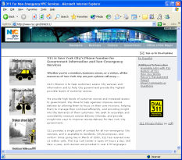
New York City’s BI Vision – A Journey
Management
Information
Enterprise
BI Capabilities
Audiences
City Hall
Performance Management Metrics (ALL Agencies)
Management Dashboards
Ad Hoc Query
Agencies
Performance Scorecards
Spatial Analysis (GIS)
3-1-1 Operations
Alerting
Public
Coming Next!

Slide 18

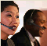



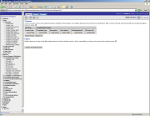




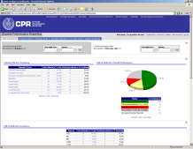

NYC’s Solution – Phase 1
Management
Information
Enterprise
BI Capabilities
Audiences
Oracle
BI
Server
City Hall
Proactive
Notification
and Alerts
3-1-1 Data Sources
Common
Data
Model
Agencies
Nortel
Ad hoc
Analysis
Oracle Data Warehouse
Agency Data Sources
3-1-1 Operations
Oracle Spatial
Interactive
Dashboards
Citywide Performance Management Data Sources
Public

Slide 19


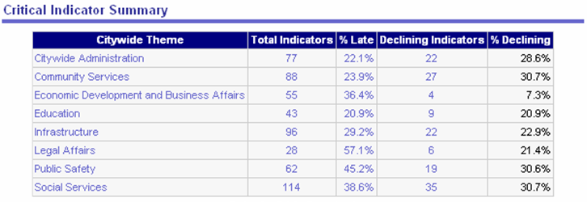

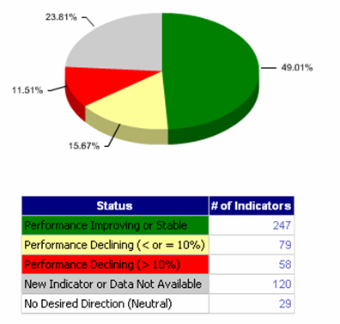
NYC Citywide Performance Reporting (CPR)
Summarize critical citywide metrics by functional area. Drill through to investigate details, declining indicators, etc.
Quick performance summary based on filtered metrics. Allows drill through.

Slide 20
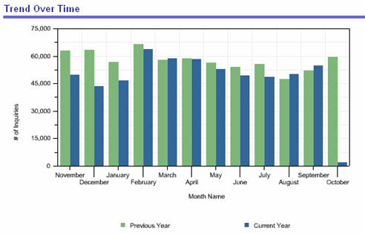
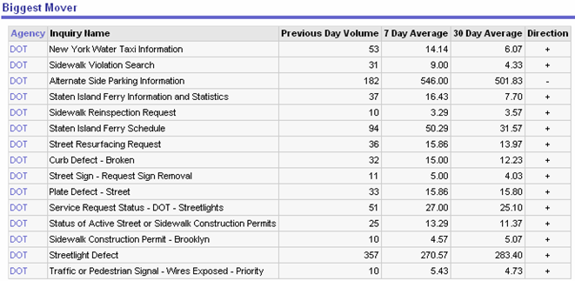
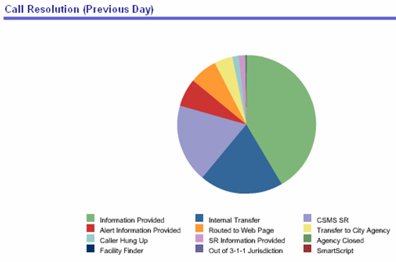
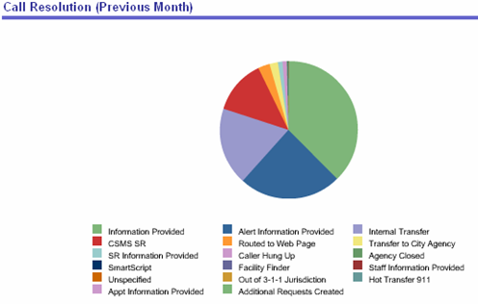
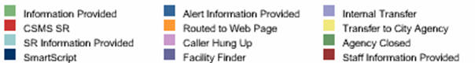

NYC Citywide Performance Reporting (CPR)
Trend Over Time
Biggest Mover
Call Resolution (Previous Month)
Call Resolution (Previous Day)

Slide 21
Citywide Performance Reporting (CPR)
Outcomes To Date
Incorporated into Mayoral Management process
Transparency and Accountability
Increasing the number of Outcome-based Performance Metrics
Trend analysis led to service delivery improvements (e.g., road quality, street cleanliness, 3-1-1 operations)
Geographic and cross-agency analysis helping to improve service delivery

Slide 22
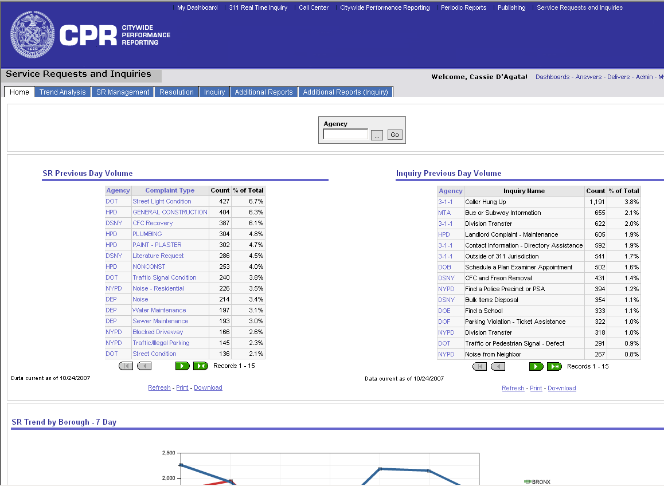
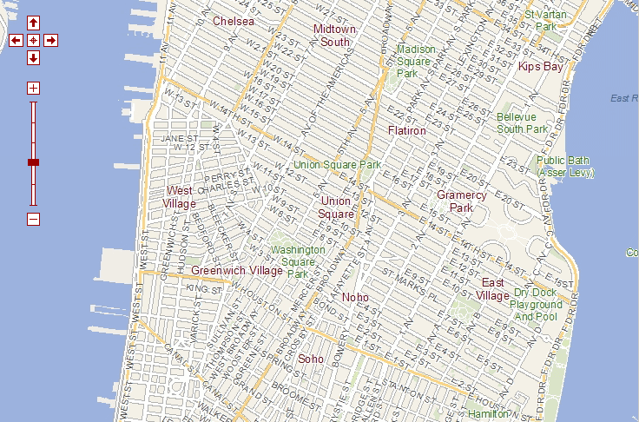
What’s Next: Geographic Analysis
Drill though the summary query results to produce a map of the spatial query.
Service Request Map
LEGEND
1
2 - 10
11 - 25
25 - 50

Slide 23

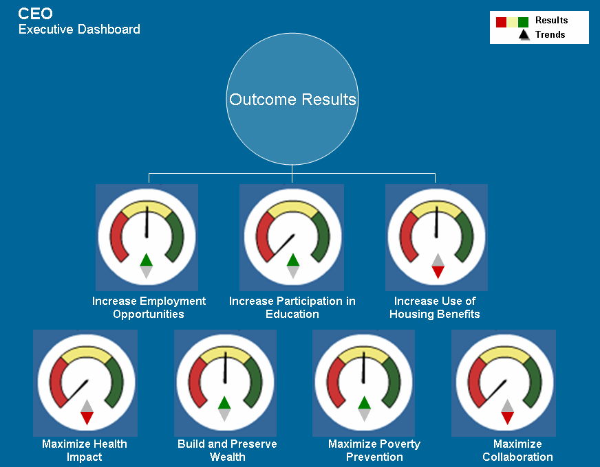
What’s Next: Performance Scorecards
Center for Economic Opportunity
Executive Dashboard
Citywide
Economic Opportunity
Transportation
Customer Service
Quality of Life
Public Safety
Drill through from summary outcomes to sub-outcomes and supporting metrics

Slide 24
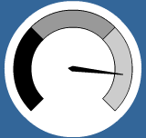
What’s Next: Performance Scorecards
Metric #1.1.1
➲
➲
Goal #1.1.1
Goal #1.2.1
Metric #1.2.2
%
Sub-Outcome #1.1
Outcome #1
Goal #1.2.1
Goal #1.2.2
Goal #1.2.3
Metric #1.2.1
Sub-Outcome #1.2
➲
➲
➲
%
Metric #1.2.2
Metric #1.2.3
%
Sub-Outcomes #2.1
➲
➲
Goal #2.1.1
Goal #2.1.2
Metric #2.1.1
Metric #2.1.2
Outcome #2
Sub-Outcome #2.2
➲
➲
➲
Goal #2.2.2
Goal #2.2.3
Goal #2.2.4
%
Metric #2.2.1
Metric #2.2.2
Sub-Outcome #2.3
➲
➲
➲
➲
Goal #2.3.1
Goal #2.3.2
Goal #2.3.3.
Goal #2.3.4
%
Metric #2.3.1
Metric #2.3.2
Metric #2.3.3

Slide 25
NYC CPR: Summary
Mix of measures: inputs, outputs, processes and outcomes
Enterprise platform for BI initiatives throughout NYC
“Single Truth” for summary metrics and management analysis
Executive Sponsorship advocate data sharing
“Competing on Analytics” – movement from measurement to management
Use outcomes and metrics to run government like a business

Slide 26
Roadmap
Stage
1
Analytical
Impaired
Stage
2
An organization has some data
and management interest in analytics
Functional management
builds analytics momentum
and executives’ interest
through application of
basic analytics
Localized
Analytics
Managerial
Support:
Prove-it Path
Top management support:
Full-Steam-Ahead Path
Stage
3
Analytical
Aspirations
Executives commit to analytics
by aligning resources and setting
a timetable to builds a broad
analytical capability
Terminal stage: some
organizations’ analytics
efforts never receive
management support and
stall here as a result
Stage
4
Analytical
Organizations
Enterprise-wide analytics
capability under development;
top executives view analytic
capability as a corporate priority
Stage
5
Analytical
Leaders
Organization routinely reaping
benefits of its enterprise-wide
analytics capability and focusing
on continuous analytics renewal

Slide 27
Analytics Technologies
Using data to understand, analyze, and guide business performance.
Business Intelligence
What’s the best that can happen?
What will happen next?
What if these trends continue?
Why is this happening?
Optimization
Predictive Modeling
Forecasting/extrapolation
Statistical analysis
Analytics
Competitive Advantage
Alerts
Query/drill down
Ad hoc reports
Standard reports
What actions are needed?
Where exactly is the problem?
How many, how often, where?
What happened?
Access and
Reporting
Sophistication of Intelligence

Slide 28
Benefits Summary
Integrated Data
Streamlined and Transformed Technology Environment
Better Decision Making
Improved Understanding of Customers and Citizens – Better and More Focused Service
Improved Strategies
Improved Performance (Financial, etc.)
Improved Compliance

